Slide 1


Project Title :
Mushroom CLASSIFICATION
Dhruvit Patel
ID: 10404032
Course: CS-513 (Spring 2015)
Prof. Mahmoud Daneshmand

Slide 2
Roadmap
Introduction
Method
CRISP-DM
Business Understanding
Profound question
Goal
Data Understanding
Data Source
Attribute Description
Data Preparation
Missing Values
Attribute Transformation
Sample Data
Modeling
Data Mining Algorithms
Optimal decision tree
Tree Visulization
Node Visulization
Testing Result
Decision Rules
Viewing the Main Spliters
Evaluation
Varriable Importance
Root Competitor Splits
Deployment
References

Slide 3
Introduction
A large number of mushroom species are favored for eating by North American in pizza and in the fast food. By examining a mushroom, it’s hard to identify in edible or poisonous. It’s required a lot of knowledge about type of mushroom and where its found ?
According to the toxicology report of the North American Mycological Association (NAMA), over the past 35 years an average 2-3 people per year die of mushroom poisoning and the lack of identification knowledge. So, there is need of analyzing mushroom species to get better and keen identification of mushroom.
Notes:
introduction of problem

Slide 4
Method
First, we build classification model to uncover patterns by using characteristics of mushroom’s different parts which are used to classify mushroom in edible and poisonous.
Then, we used this classification tree and patterns to validate test data (future data) for accuracy.
The CRISP-DM process is used to solve the problem.

Slide 5

CRISP-DM
CRISP-DM (Cross Industry Standard Process for Data Mining) is most popular process for analytics, data mining and data science projects.
This is an iterative model and next phase depends on results from preceding phase.
There are 6 phases:

Slide 6
Business
Understanding
Data
Understanding
Data
Preparation
Modeling
Evaluation
Deployment
Define
Business
Objectives
Collect
Initial
Data
Clean
Data
Select
Modeling
Technique
Evaluate
Results
Plan
Deployment
Define
Profound
Question
Describe
Data
Prepare
Data
Generate
Test Design
Review
Process
Plan Monitoring
&
Maintenance
Determine
Data Mining
Goals
Verify
Data
Quality
Transform
Data
Build
Model
Determine
Next Steps
Produce
Final
Report
Prepare
Initial
Strategy
Exploratory
Data
Analysis
Select Variables
Appropriate to
Analysis
Assess
Model
Review
Project

Slide 7
Business Understanding
What is Profound question ?
Can a modeler classify the given mushroom in edible or poisonous ?
Goal
To build classification tree using data mining technique and derive decision rules for proper identification of mushroom in edible and poisonous.
Result
By having decision rules, we can identify mushroom properly.

Slide 8
Data Understanding
This data is collected from UCI Machine Learning Repository.
Data Source: https://archive.ics.uci.edu/ml/datasets/Mushroom
This Data set includes description of 23 species of gilled mushroom. Each mushroom is identified as edible and poisonous.
It consist 22 attributes(Characteristics of Mushroom’s different parts) that are categorical variables and total 8124 instances(rows).
It consist 1 target attribute. Target attribute classify mushroom into edible(e) and poisonous(p).

Slide 9
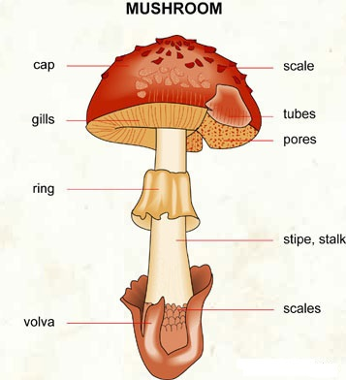
Attribute description…
1. cap-shape: bell=b, conical=c, convex=x, flat=f, knobbed=k, sunken=s
2. cap-surface: fibrous=f, grooves=g, scaly=y, smooth=s
3. cap-color: brown=n, buff=b, cinnamon=c, gray=g, green=r, pink=p, purple=u, red=e, white=w, yellow=y
4. bruises?: bruises=t, no=f
5. odor: almond=a, anise=l, creosote=c, fishy=y, foul=f, musty=m, none=n, pungent=p, spicy=s
6. gill-attachment: attached=a, descending=d, free=f, notched=n
7. gill-spacing: close=c, crowded=w, distant=d

Slide 10
Cont’d…
8. gill-size: broad=b, narrow=n
9. gill-color: black=k, brown=n, buff=b, chocolate=h, gray=g, green=r, orange=o, pink=p, purple=u, red=e, white=w, yellow=y
10. stalk-shape: enlarging=e, tapering=t
11. stalk-root: bulbous=b, club=c, cup=u, equal=e, rhizomorphs=z, rooted=r, missing=?
12. stalk-surface-above-ring: fibrous=f, scaly=y, silky=k, smooth=s
13. stalk-surface-below-ring: fibrous=f, scaly=y, silky=k, smooth=s
14. stalk-color-above-ring: brown=n, buff=b, cinnamon=c, gray=g, orange=o, pink=p, red=e, white=w, yellow=y
15. stalk-color-below-ring: brown=n, buff=b, cinnamon=c, gray=g, orange=o, pink=p, red=e, white=w, yellow=y

Slide 11
Cont’d…
16. veil-type: partial=p, universal=u
17. veil-color: brown=n, orange=o, white=w, yellow=y
18. ring-number: none=n, one=o, two=t
19. ring-type: cobwebby=c, evanescent=e, flaring=f, large=l, none=n, pendant=p, sheathing=s, zone=z
20. spore-print-color: black=k, brown=n, buff=b, chocolate=h, green=r, orange=o, purple=u, white=w, yellow=y
21. population: abundant=a, clustered=c, numerous=n, scattered=s, several=v, solitary=y
22. habitat: grasses=g, leaves=l, meadows=m, paths=p, urban=u, waste=w, woods=d
23. Target: edible=e, poisonous=p

Slide 12
Data Preparation
Most of the dataset of mushroom is consistent except for some missing values.
The attribute “stalk-root” had some missing values and missing values shown by “?” . There are total 2408 instances with missing values.
For handling missing values, we are replaced missing values with most usable attribute value.
For “stalk-root”,
b = 3776 rows
c = 556 rows
e = 1120 rows
r = 192 rows
? = 2480 rows
So, we replaced “?” with “b” attribute value.

Slide 13
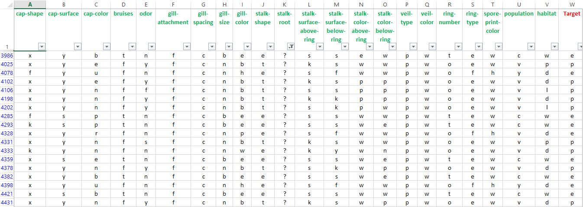
Data with missing values…
“stalk-root” attribute with missing values (“?”)

Slide 14
Predefine Logical rules…
Scientist discover some logical rules to classify mushroom but they are not 100% enough to solve our problem.
Given disjunctive logical rules use for poisonous mushroom.
Odor = NOT(almond.OR.anise.OR.none)
Spore-print-color = green
Habitat = leaves.AND.cap-color = white
Rule 3. may also be
3’. Population = clustered.AND.cap_color = white
Rules for edible mushroom are obtained as negation of the rules given above, For example the rule:
odor=(almond.OR.anise.OR.none).AND.spore-print-color=NOT.green

Slide 15
Data transformation
By analyzing full sets of predefine logical rules, we can define new attribute named as Target attribute for making classification easy.
Target attribute is categorical attribute and having two values edible(e) and poisonous(p).
Class distribution.
edible: 4208 (51.8%)
poisonous: 3916 (48.2%)
total: 8124 instances

Slide 16
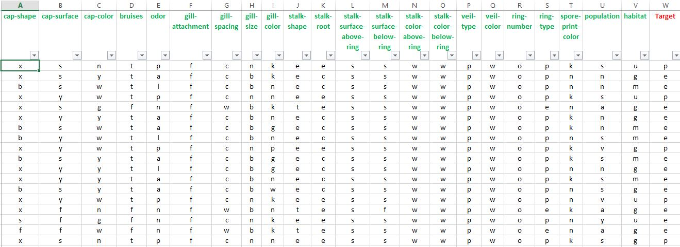
Sample Data

Slide 17
Modeling
For modeling phase, we need to select a data mining algorithm according to our datasets and objectives. Our objectives is to classify datasets into “edible” and “poisonous” and uncover matching pattern.
In the Data Mining, there is two algorithm for classification.
CART (Classification And Regression Trees)
C4.5
CART algorithm handles missing values and we can easily interpret decision tree for both small and medium dataset. CART evaluates all independent variables, then choose optimal split and also CART has automatic post-pruning for reducing classification error.
C4.5 has poor performance in medium datasets. C4.5 splits categorical variables is that it may lead to an overly bushy tree, with many leaf nodes containing few records.
So, the CART Algorithm seems to be fulfill our requirements for this problem.

Slide 18
Cont’d…
Appropriate Software Tool to be used….
We will use CART algorithm provided by Salford Predictive Modeler.
Site reference: www.salford-system.com
Features:
CART (Decision tree with better visualization )
Linear Combination Splits
Optimal tree selection based on area under ROC curve

Slide 19
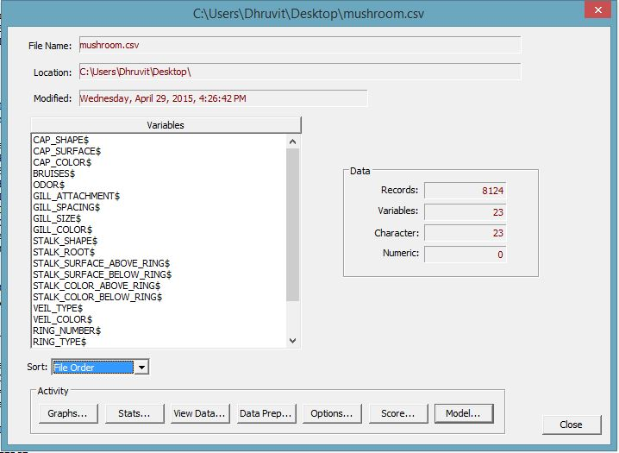
Opening Data file in SPM
for Classification

Slide 20
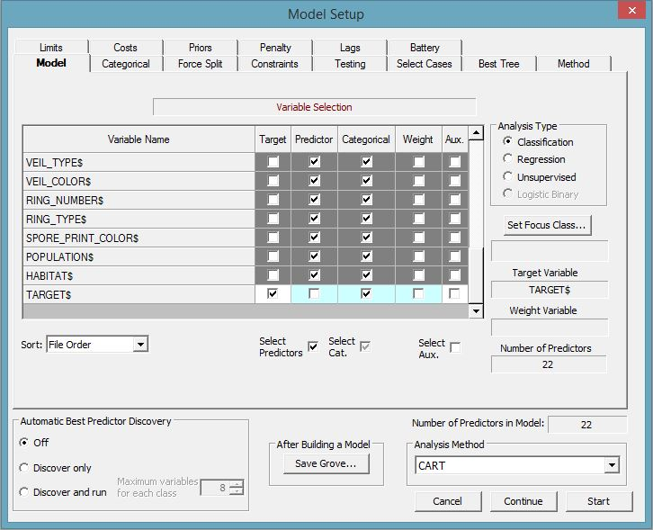
Check Predictor and
Target attribute
Select Analysis Method
as CART
Our target variable is
categorical, so; select
Analysis Type as
“Classification”.

Slide 21
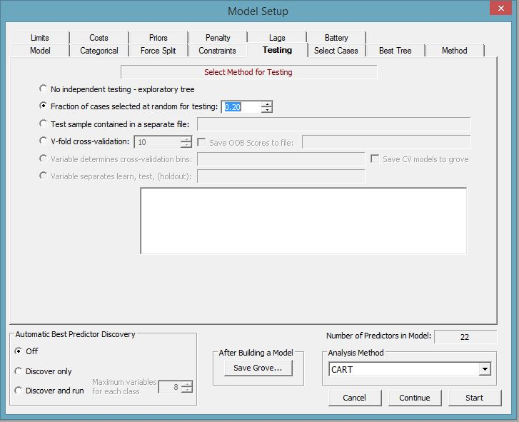
Here, we are dividing data
Training Data (80%)
Test Data (20%)

Slide 22
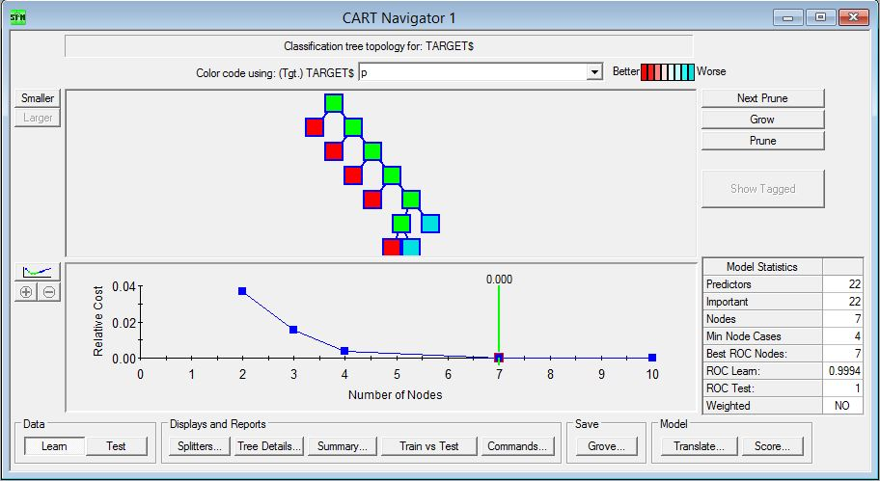
This is the optimal decision tree.
Maximum ROC Test and Minimum classification error

Slide 23
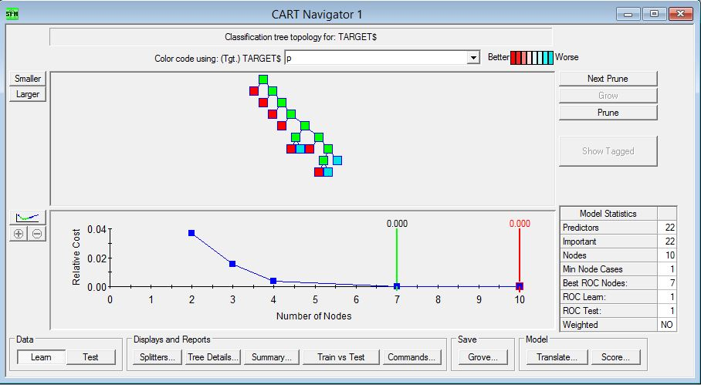
Fully grow decision tree with 10 leaf node.

Slide 24
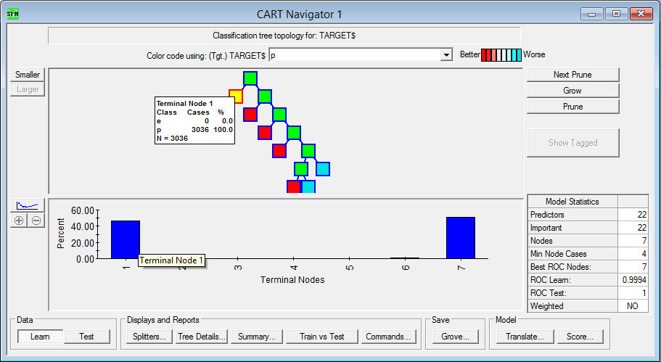
There is only two node having maximum amount of instances.
Terminal Node-1 have maximum classification

Slide 25
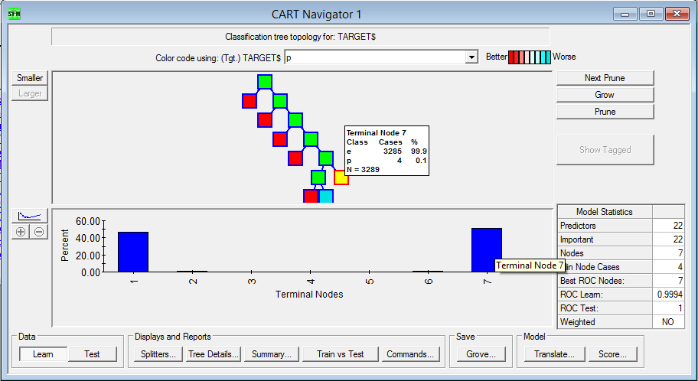
Terminal Node-7 have maximum classification

Slide 26
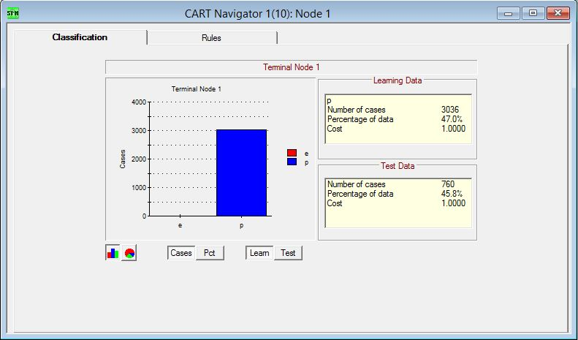
Classification percentage for Test Data is almost similar to Learning Data
For Node-1

Slide 27
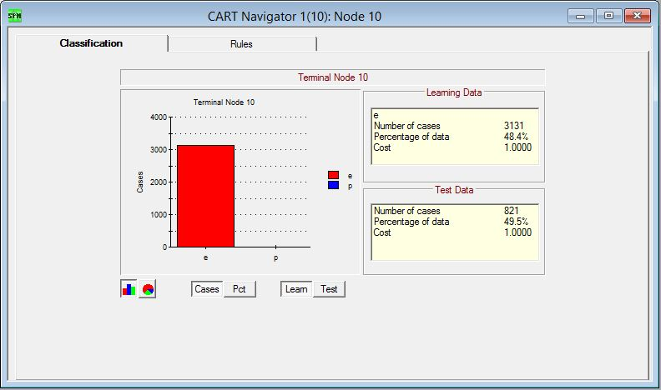
Classification percentage for Test Data is almost similar to Learning Data
For Node-7

Slide 28
By analyzing above 4 slide, we can say that only terminal Node-1 and Node-7 are most
important nodes for classification.
/*Rules for terminal node 1*/
if
(
(
ODOR$ == c ||
ODOR$ == f ||
ODOR$ == m ||
ODOR$ == p ||
ODOR$ == s ||
ODOR$ == y
)
)
{
terminalNode = 1;
class = p;
}
So most probably, we require decision rules
for only Node-1 and Node-7 for mushroom
classification.

Slide 29
/*Rules for terminal node 7*/
if
(
(
STALK_COLOR_BELOW_RING$ == e ||
STALK_COLOR_BELOW_RING$ == g ||
STALK_COLOR_BELOW_RING$ == o ||
STALK_COLOR_BELOW_RING$ == p ||
STALK_COLOR_BELOW_RING$ == w
) &&
(
CAP_SURFACE$ == f ||
CAP_SURFACE$ == s ||
CAP_SURFACE$ == y
)
&&
(
SPORE_PRINT_COLOR$ == b ||
SPORE_PRINT_COLOR$ == h ||
SPORE_PRINT_COLOR$ == k ||
SPORE_PRINT_COLOR$ == n ||
SPORE_PRINT_COLOR$ == o ||
SPORE_PRINT_COLOR$ == u ||
SPORE_PRINT_COLOR$ == w ||
SPORE_PRINT_COLOR$ == y
) &&
(
ODOR$ == a ||
ODOR$ == l ||
ODOR$ == n
)
)
{
terminalNode = 7;
class = e;
}

Slide 30
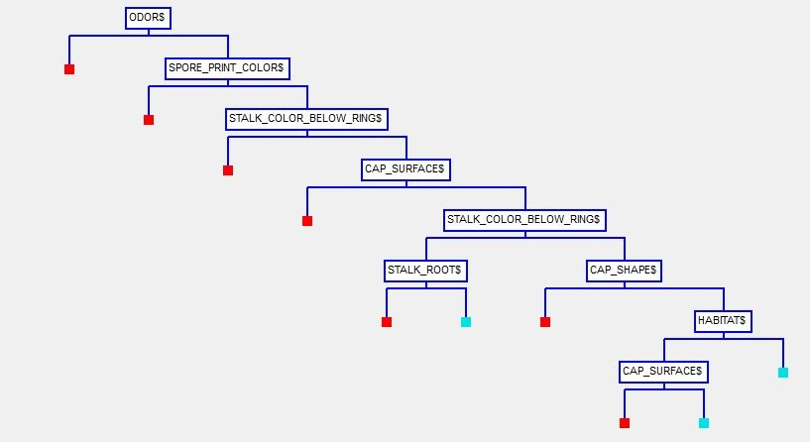
Viewing the main Splitters:
Gives information about the attributes that were used at each level of splitting.
Poisonous
Mushroom
Edible
Mushroom

Slide 31
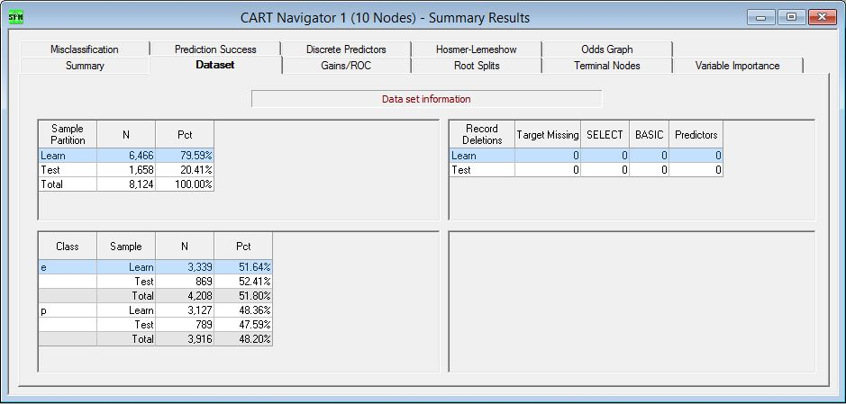
Evaluation
Target Missing is zero for both data set
It shows that accuracy is 100%
Classification percentages are all most same for learning and testing data

Slide 32
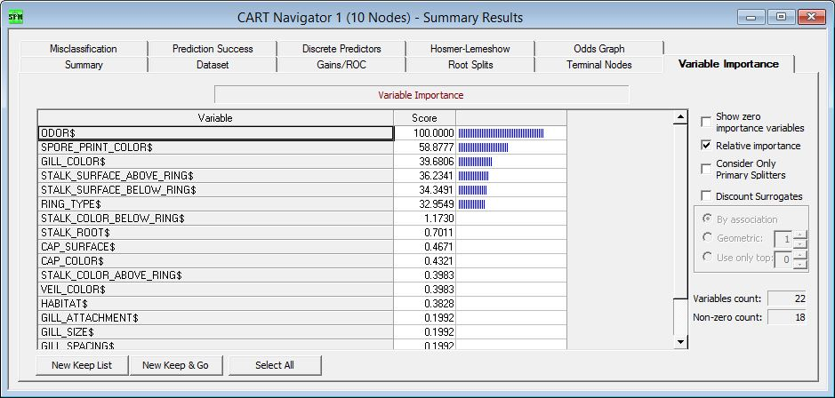
Viewing variable importance:
Attribute importance’s score needed for classification.
“ODOR” attribute has highest importance score.

Slide 33
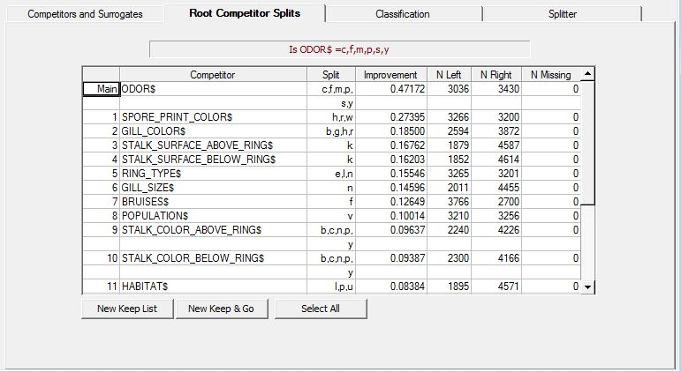
Root Competitor Splits
Describe a special interest in the performance of variable as splitters in the root.
List of Competitor according to their improvement strength.

Slide 34
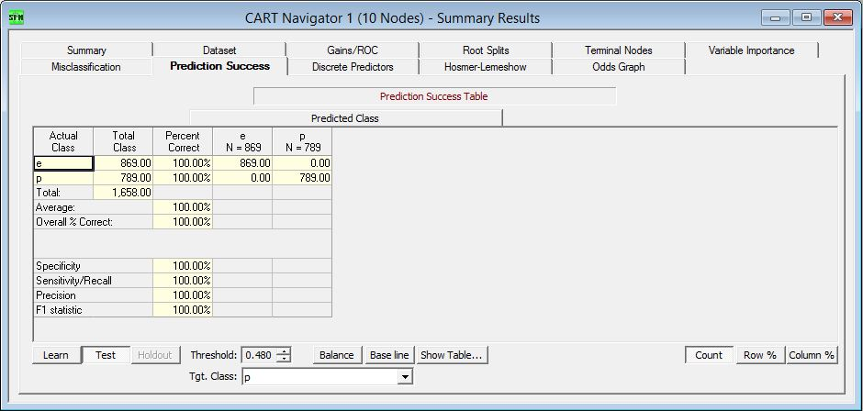
Viewing Prediction Success Table
For Test Data, Prediction success rate is 100% for both class edible(e) and poisonous(p)

Slide 35
Deployment
Usability:
With use of Decision rules, we can develop mobile application for wild life commuters to help them. By using application, one can scan mushroom parts and easily identify whether it is edible or poisonous.
We also provide this Data Mining information through website for farmers to understand mushroom very well.
Scientist will use this data set for future analysis.

Slide 36
References
Data Source : https://archive.ics.uci.edu/ml/datasets/Mushroom
http://www.salford-systems.com/products/cart
Lecture Notes and Slides
Daniel T. Larose, Discovering Knowledge in DATA: An Introduction to DATA MINING, John Wiley, 2005

